Slide 1
Time Value of Money 1: Analyzing Single Cash Flows
4
Topic 4

Slide 2
Historical Foundations
The Ascent of Money
Segment 1: 8:15 – 12:30
Mathematics and the time value of money
Segment 2: 27:00 – 34:45
The importance of bond financing
Want to watch more? The next innovation…. the stock market.

Slide 3
Think about it
What is finance? Why is it so important in history? What two options are available to finance activities?
How do lenders make money? Why do lenders charge interest?
What developments were necessary for the progress and success of borrowing and lending in Europe? How do accountants play a vital role in the operation of markets, like the bond market?
What personal developments do you need to contribute to successful lending and finance?

Slide 4
Introduction
Time value of money (TVM)
Refers to the difference in buying power for a dollar over time
Used by financial and nonfinancial business managers
Key to making sound personal financial decisions

Slide 5
Future Value

Slide 6
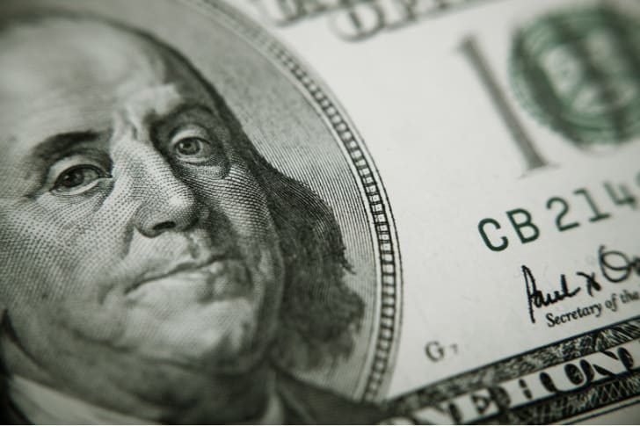
The Power of Compound Interest
In 1790, Benjamin Franklin left 1000 pounds sterling ($4000 at the time) to Boston and Philadelphia as a trust.
For the first 100 years the proceeds were used to fund loans for tradesmen starting out. At the end of 100 years 75% of the principal could be used for public works projects.

Slide 7
The Power of Compound Interest
The remaining 25% was to remain and its proceeds used by Massachusetts and Pennsylvania in any way they chose after another 100 years.
How much was left after 200 years?

Slide 8

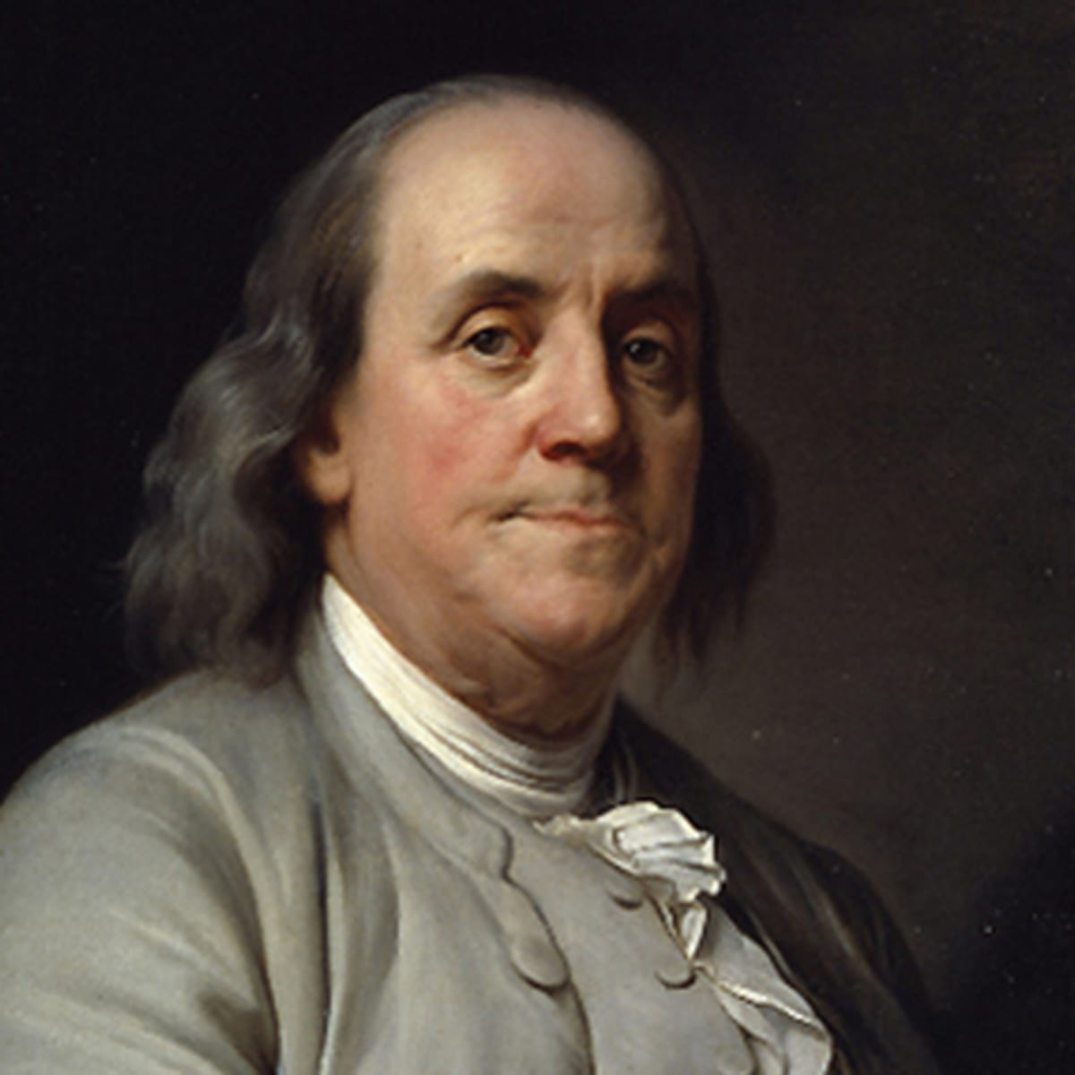

The Power of Compound Interest
Massachusetts received $4.5 million
Pennsylvania received $2 million

Slide 9
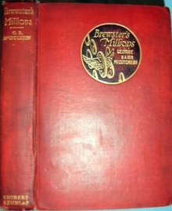
The Power of Compound Interest
Montgomery Brewster, a young man who inherits one million dollars from his rich grandfather. Shortly after, a rich uncle also dies.
This uncle hated Brewster's grandfather, a long-held grudge stemming from the grandfather's disapproval of the marriage of Brewster's parents.
The uncle will leave Brewster seven million dollars, but only under the condition that he keeps none of the grandfather's money. Brewster is required to spend every penny of his grandfather's million within one year, resulting in no assets or property held from the wealth at the end of that time. If Brewster meets these terms, he will gain the full seven million; if he fails, he remains penniless.
There are some rules on how to spend the money – nothing on himself.

Slide 10
Future Value
Future value is the value of an investment after one or more periods
For example, the $105 payment your bank credits to your account one year from the original $100 investment at 5% annual interest

Slide 11

Single-Period Future Value
To compute the future value of a sum of money one year from today, add interest earned to today’s cash

Slide 12

Single-Period Future Value Example
Example
You invest $100 today
You will earn 5% interest annually (for one period)
Period
0
5%
1
Cash flow
$100
$105

Slide 13

Compounding and Future Value Example
Example
You invest $100 today
You will earn 5% interest for two periods
Period
0
5%
1
5%
2
Cash flow
$100
$105
$110.25

Slide 14
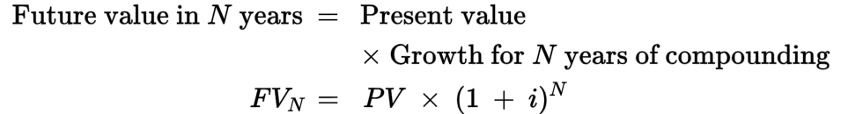
Compounding and Future Value
Compounding is the process of adding interest earned every period on both the original investment and the reinvested earnings

Slide 15
Excel example
Would you rather have $100 today or $200 in the future?
Answer: It depends
Interest rate?
How long will it be?

Slide 16
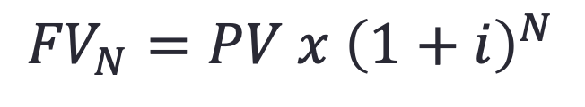
Excel examples
$${FV}_{N}=PV x {\left(1+i\right)}^{N}$$
See Canvas
Example 1
Example 2

Slide 17
Thinking about Future value
Do you save? Do you invest?
What have you learned about the power of compounding?
How sensitive are future values to the interest rate?
Do future values grow when the interest rate is 0? Try it.

Slide 18
Future Value Example Question 1
How much would be in your savings account in 11 years after depositing $150 today if the bank pays 8 percent per year?

Slide 19
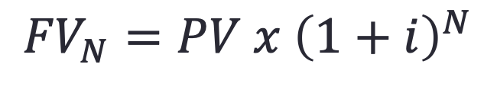
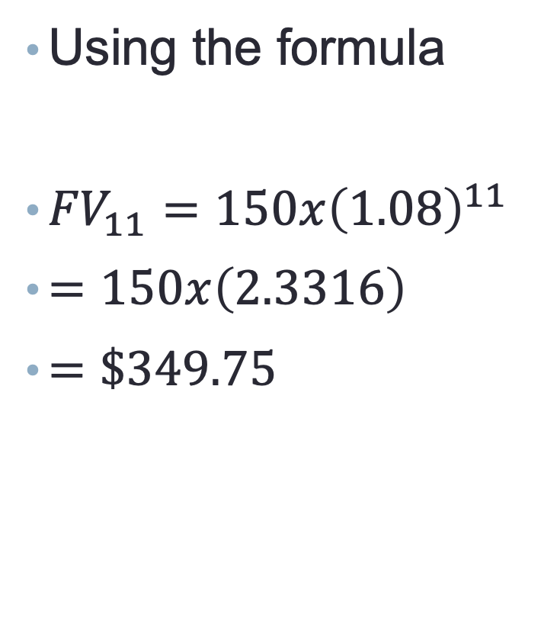
Future Value Example Question 1
Using the formula
${FV}_{11}=150x{\left(1.08\right)}^{11}$
$=150x\left(2.3316\right)$
$=\$349.75$
Using Excel
$${FV}_{N}=PV x {\left(1+i\right)}^{N}$$

Slide 20
Future Value Example
Two years ago John loaned his son, John Jr., a local grape grower, $20,000 to buy additional vineyard. The loan was for five years with interest compounded annually at 10 percent. but the loan was unamortized and no interest or principal was to be paid until the end of the five year period.
How much will John receive at the end of the five year period?

Slide 21

Future Value Example
$FV=PVx{(1+i)}^{N}$
$FV=20,000 x {(1+0.10)}^{5}$
$FV=20,000 x 1.61051$
=32,210

Slide 22
Future Value Example Question 2
A deposit of $350 earns the following interest rates: 8 percent in the first year. 6 percent in the second year. 5.5 percent in the third year. What would be the third year future value?
What would be the value after three years? Is the answer the same?
Consider Formula 4-3
Multiple rates future value example question 2.xlsx

Slide 23
Think about it
How do your calculated future values change as interest rates go up and down?

Slide 24
Present Value

Slide 25
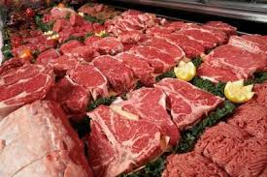
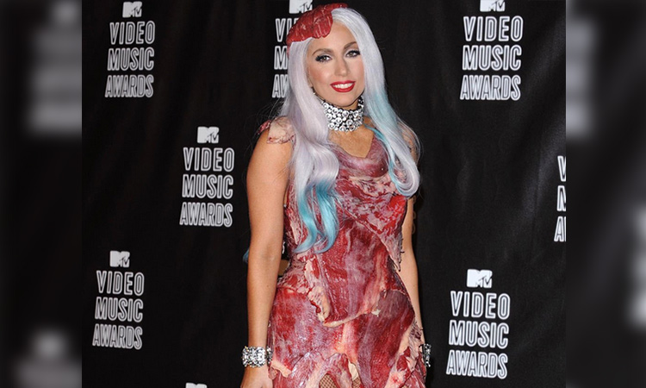
Introduction
Notes:
Lady Gaga wore this dress in 2010

Slide 26
Introduction
How do you feel about consuming the meat in this situation?
Would you rather consume meat that was refrigerated or fresh rather than having been left out?
On a scale of 1 to 10, how dissatisfied are you with the idea of consuming this meat? Would it matter if Lady Gaga were not wearing it?
Notes:
Lady Gaga wore this dress in 2010

Slide 27
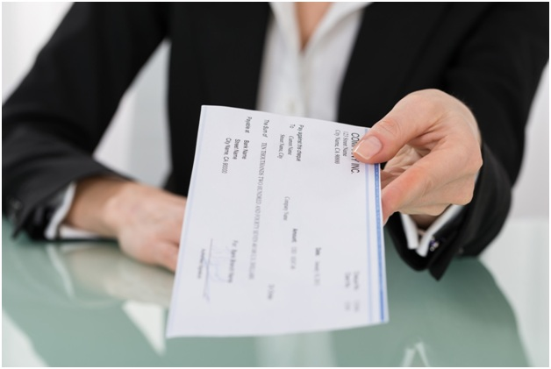
Introduction
Suppose your employer cannot pay you on time later this month.
You will get paid double mid-next month
You won’t have income for your rent
Let’s talk about it
How do you feel about this situation?
Would you rather receive your pay on time?
On a scale of 1 to 10, how dissatisfied are you?

Slide 28
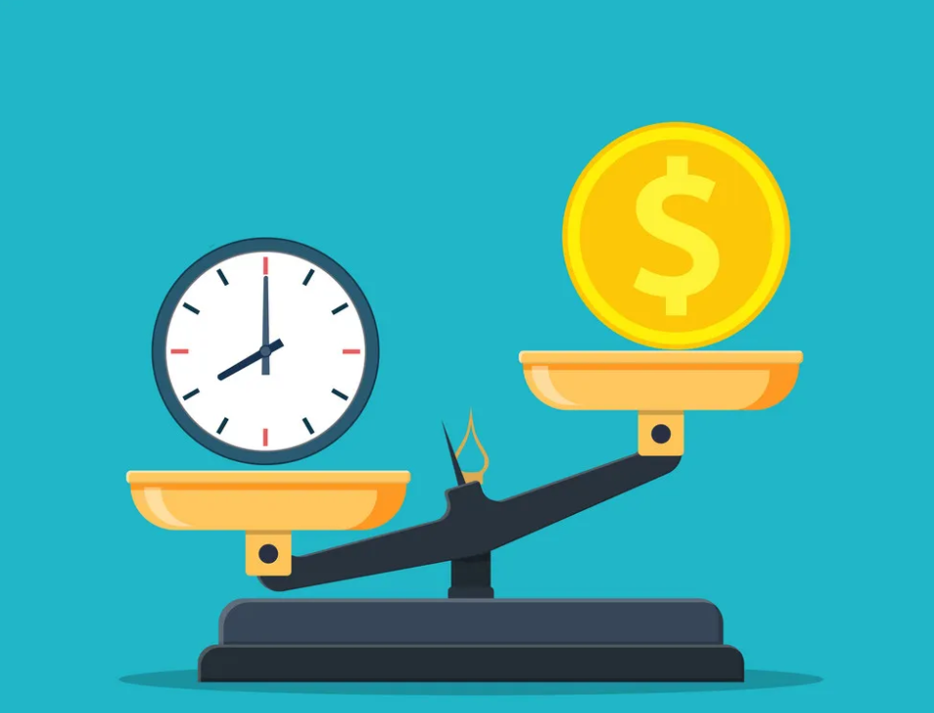
Introduction
Would you rather have $100 today or $200 in the future?
Answer: It depends
Interest rate?
How long will it be?

Slide 29
Present Value
Finding the present value is essentially the opposite process as finding the future value
Future value = compounding
Example: What happens when you deposit $100 cash in the bank to earn 5 percent interest for one year?
Present value = discounting
Example: If the bank will pay you $105 in one year and interest rates are 5 percent, how much would you be willing to deposit now, to receive that payment in a year?

Slide 30
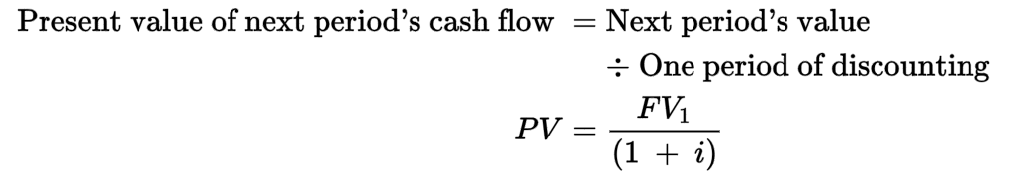
Present Value (continued)
Discounting is the process of finding present value by reducing future values using the discount, or interest, rate
Significantly decreases the value of a future amount to the present

Slide 31
Present Value Example
Example
The bank will pay you $105 in 1 year
Interest rates are 5 percent
What is the present value?

Slide 32
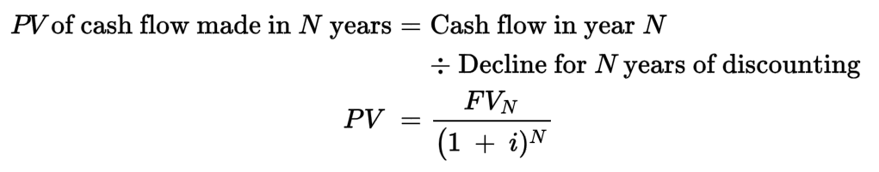
Discounting Over Multiple Periods
Discounting over multiple periods is the reverse of compounding over multiple periods

Slide 33
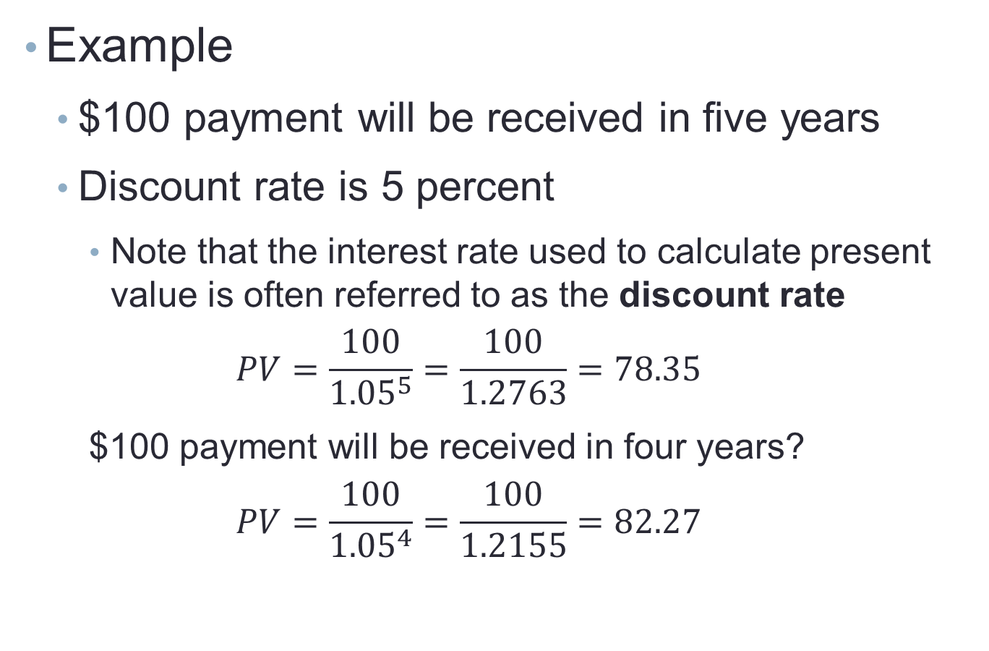
Discounting Over Multiple Periods Example
Example
$100 payment will be received in five years
Discount rate is 5 percent
Note that the interest rate used to calculate present value is often referred to as the discount rate
$$PV=\frac{100}{{1.05}^{5}}=\frac{100}{1.2763}=78.35$$
$100 payment will be received in four years?
$$PV=\frac{100}{{1.05}^{4}}=\frac{100}{1.2155}=82.27$$
This number is larger than that one. Why does this make sense?

Slide 34
Discounting Multiple Payments Over Multiple Periods Example
In negotiating the sale of some machinery to his son, Harry agreed to accept interest and principal payments of $10,000 in one year, $15,000 in two years, and $22,000 in three years (in line with the son's ability to pay). If Harry can earn nine percent on invested funds, how much is he receiving for the machinery?

Slide 35
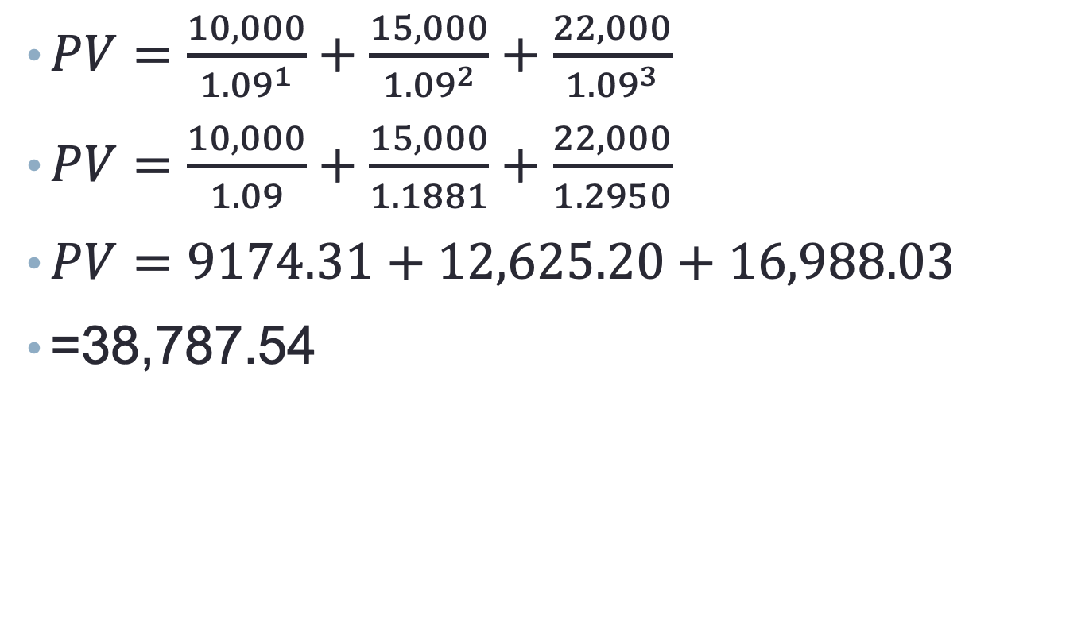
Discounting Multiple Payments Over Multiple Periods Example
$PV=\frac{10,000}{{1.09}^{1}}+\frac{15,000}{{1.09}^{2}}+\frac{22,000}{{1.09}^{3}}$
$PV=\frac{10,000}{1.09}+\frac{15,000}{1.1881}+\frac{22,000}{1.2950}$
$PV=9174.31+12,625.20+16,988.03$
=38,787.54

Slide 36

Excel examples
$PV= \frac{{FV}_{N}}{{\left(1+i\right)}^{N}}$
Present Value Example 1.xlsx
Present Value Example 2.xlsx
Present Value Example 3.xlsx
What happens to the PV when the interest rate goes up? Down?
What happens to the PV when the number of years away the payment will be goes up? Down?
What is the difference between Excel’s PV and NPV functions?

Slide 37
Present Value Example Question 1
What is the present value of a $1,500 payment made in nine years when the discount rate is 8 percent?

Slide 38

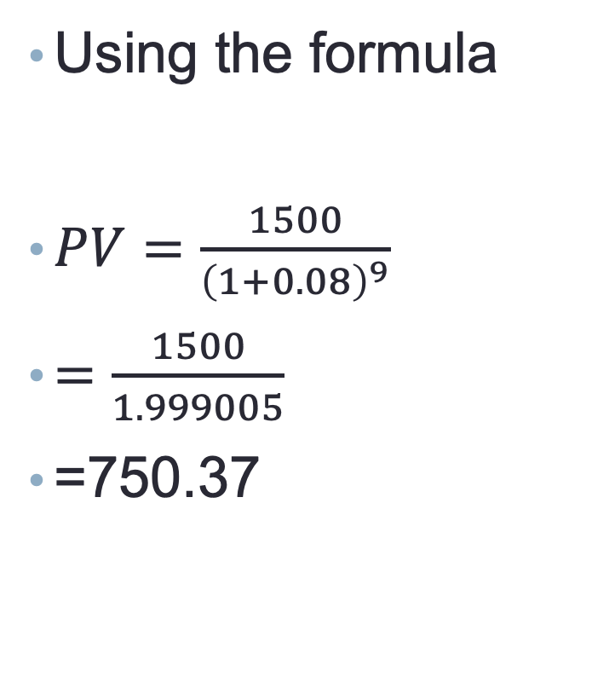
Present Value Example Question 1
Using the formula
$PV=\frac{1500}{{\left(1+0.08\right)}^{9}}$
$=\frac{1500}{1.999005}$
=750.37
Using Excel
$$PV= \frac{{FV}_{N}}{{\left(1+i\right)}^{N}}$$
PV Example Question 1.xlsx

Slide 39
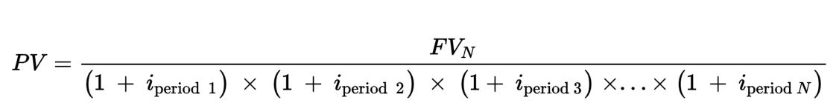
Discounting with Multiple Rates
A future cash flow can be discounted at different interest rates per period

Slide 40

Discounting with Multiple Rates Example
Example
Bank will pay you $2,500 at the end of 3rd year
Interest rate in year 1 = 7%
Interest rate in year 2 = 8%
Interest rate in year 3 = 8.5%
How much do you need to deposit now?

Slide 41
Discounting with Multiple Rates Example
Notice the difference.
Each rate appears for one year
Earlier examples had a constant rate

Slide 42
Examples
Use Excel or working by hand to answer the following:
Consider two situations:
You will receive $1000 3 years from now
You will receive $100 at the end of each of the next 3 years
What is the present value of these if the interest rate is 10%?
What is the present value of these if the interest rate is 8%?
What is the present value of these if the interest rate is 12%?

Slide 43
Present vs. future value

Slide 44
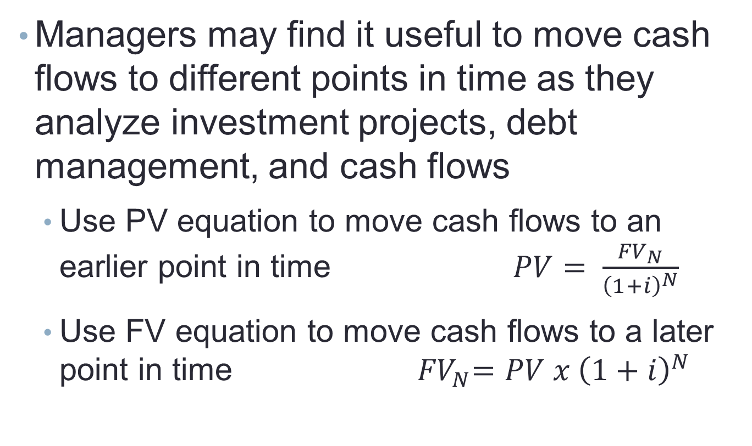
Using Present Values and Future Values
Managers may find it useful to move cash flows to different points in time as they analyze investment projects, debt management, and cash flows
Use PV equation to move cash flows to an earlier point in time $PV= \frac{{FV}_{N}}{{\left(1+i\right)}^{N}}$
Use FV equation to move cash flows to a later point in time ${ FV}_{N}=PV x {\left(1+i\right)}^{N}$

Slide 45

Present Values and Future Values Example
Example
What’s the value in year 2 of a $200 cash flow to be received in three years, when interest rates are 6 percent?
Problem requires moving $200 payment in the third year to a value in the second year, which means we need to use the PV equation

Slide 46

Present and Future Value Example (continued)
Example
What about moving the $200 cash flow to year 5?
Requires moving the cash flow later in time by two years, so we use the future value equation

Slide 47
Moving cash flow example 1
What is the value in year 3 of a $700 cash flow made in year 6 if interest rates are 10 percent?
Consider: will you be discounting or compounding the $700?
Draw the timeline

Slide 48

Moving cash flow example 1
${PV}_{3}=\frac{{FV}_{6}}{{\left(1+i\right)}^{N}}$
$=\frac{700}{{\left(1+.10\right)}^{6−3}}$
$=\frac{700}{1.331}$
=525.92

Slide 49
Investment rates of return

Slide 50
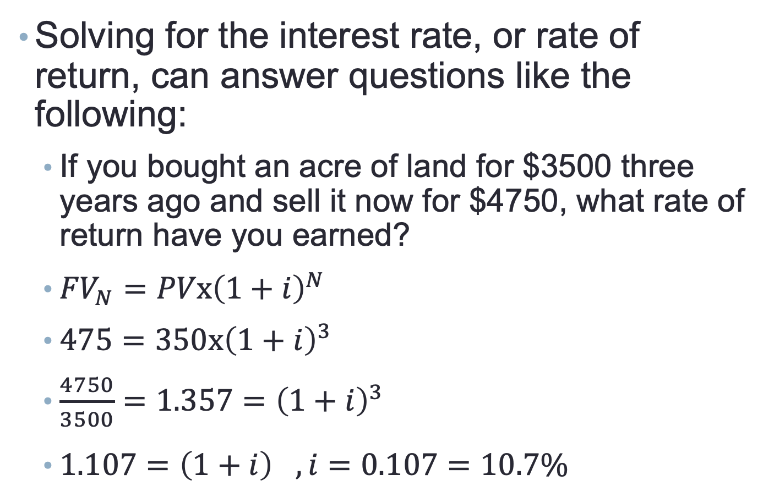
Computing Interest Rates
Solving for the interest rate, or rate of return, can answer questions like the following:
If you bought an acre of land for $3500 three years ago and sell it now for $4750, what rate of return have you earned?
${FV}_{N}=PVx{\left(1+i\right)}^{N}$
$475=350x{\left(1+i\right)}^{3}$
$\frac{4750}{3500}=1.357={\left(1+i\right)}^{3}$
$1.107={\left(1+i\right)}^{}, i=0.107=10.7\%$

Slide 51
Computing Interest Rates: Using the RATE function
Solving for the interest rate, or rate of return, can answer questions like the following:
If you bought a gold coin for $350 three years ago and sell it now for $475, what rate of return have you earned?
Syntax:
RATE(Periods, Payment, Present, Future)
RATE function example 1.xlsx

Slide 52
Example: Solve for the rate
What annual rate of return is earned on a $1,000 investment when it grows to $1,800 in six years?

Slide 53
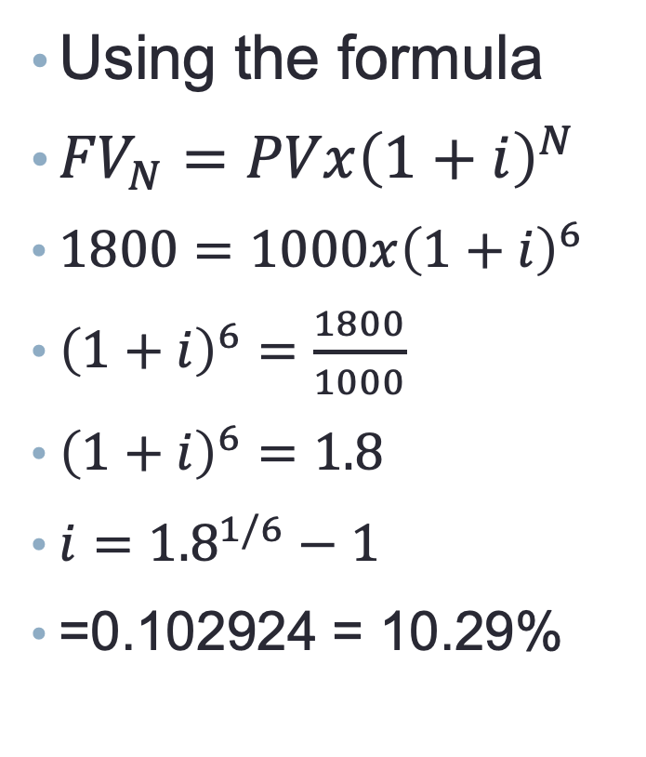
Example: Solve for the rate
Using the formula
${FV}_{N}=PVx{\left(1+i\right)}^{N}$
$1800=1000x{\left(1+i\right)}^{6}$
${\left(1+i\right)}^{6}=\frac{1800}{1000}$
${\left(1+i\right)}^{6}=1.8$
$i={1.8}^{1/6}−1$
=0.102924 = 10.29%
Using Excel
Syntax:
RATE(Periods, Payment, Present, Future)
RATE function example 2.xlsx

Slide 54
Number of compounding periods

Slide 55
Solving for Time
It may be useful to determine the time period needed to accumulate a specific amount of money
Information needed to solve for the number of years that you will need to accumulate that money
Starting cash flow
Interest rate
Future cash flow (or, the amount you will need)
Complex calculation – use Excel

Slide 56
Solving for Time Example
Question: When interest rates are 9%, how long will it take $5,000 to double?
Inputs
Interest = 9%
PV = -5,000
PMT = 0
FV = 10,000
NPER function example 1.xlsx

Slide 57
Example: Solve for time
How many years (and months) will it take $2 million to grow to $5 million with an annual interest rate of 7 percent?
Try setting this one up
Try solving for this by hand
Try solving this using Excel

Slide 58
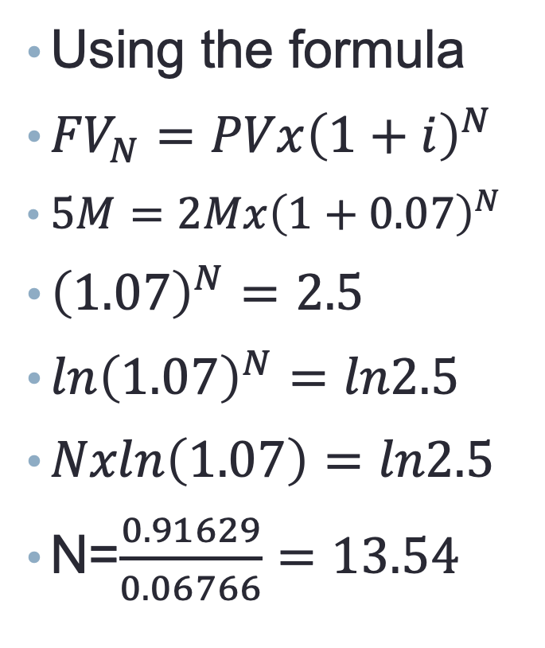
Example: Solve for time
Using the formula
${FV}_{N}=PVx{\left(1+i\right)}^{N}$
$5M=2Mx{\left(1+0.07\right)}^{N}$
${\left(1.07\right)}^{N}=2.5$
$ln{\left(1.07\right)}^{N}=ln2.5$
$Nxln\left(1.07\right)=ln2.5$
N=$\frac{0.91629}{0.06766}=13.54$
Using Excel
NPER function example 2.xlsx

Slide 59
Summary
Compounding
Discounting
Using timelines
Excel functions
FV
PV
RATE
NPER

